Slide 1
IMAGE TRANSFORMS
P.HEMA SREE
1

Slide 2
What is Image Transform?
Applying Transform we get another image of same size
After applying inverse Transform we get the original image back.
2

Slide 3
Introduction
Definition:
Image transform = operation to change the default representation space of a digital image (spatial domain -> another domain) so that:
all the information present in the image is preserved in the transformed domain, but represented differently,
the transform is reversible, i.e., we can revert to the spatial domain
3
Notes:
3

Slide 4
Introduction
A transform is essentially a mathematical mapping process.
Used in image analysis and processing to provide information regarding the rate at which the gray levels change within an image( the spatial frequency content of an image).
The principal component transform decorrelates multiband image data.
The wavelet and the haar transforms retain both spatial and frequency information
A transform maps image data into a different mathematical space via a transformation equation .
Most of the discrete transforms map the image data from the spatial domain to the frequency domain (also called the spectral domain), where all the pixels in the input (spatial domain) contribute to each value in the output (frequency domain)
4

Slide 5
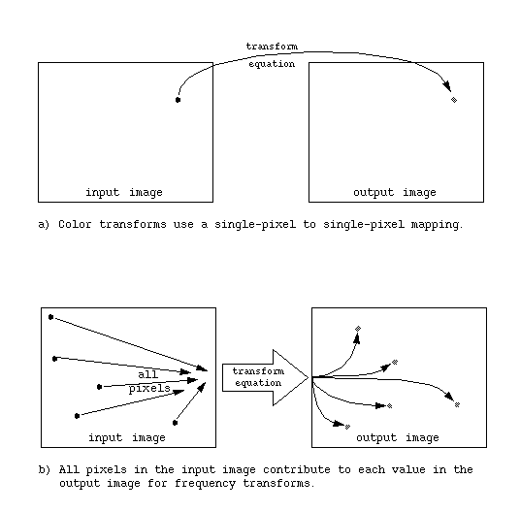
Introduction
5

Slide 6
What is the use of Image Transformation?
Applications
Preprocessing
Filtering
Enhancement, etc
Image Compression
Feature Extraction
Edge Detection
Corner detection, etc
6

Slide 7
What does an Image Transform do?
It represents the given image as a series summation of a set of Unitary Matrices.
What is a Unitary Matrix?
A Matrix ‘A’ is a unitary matrix if
A⁻¹ = A^{*T} where A* is conjugate of A
Unitary Matrix -------------------→ Basis Functions
7

Slide 8
What does an Image Transform do?
These transforms are used as tools in many areas of engineering and science, including digital imaging commonly in their discrete (sampled) forms
The discrete form is created by sampling the continuous form of the functions on which these transforms are based, that is, the basis functions
Basis vectors are sampled versions of basis functions for one-dimensional (1-D) case
8

Slide 9
What does an Image Transform do?
Basis images or basis matrices are
Two-dimensional (2-D) versions of basis vectors
The process of transforming the image data into another domain, or mathematical space, amounts to projecting the image onto the basis images
The mathematical term for this projection process is an inner product
Frequency transforms can be performed on the entire image or smaller blocks
9

Slide 10
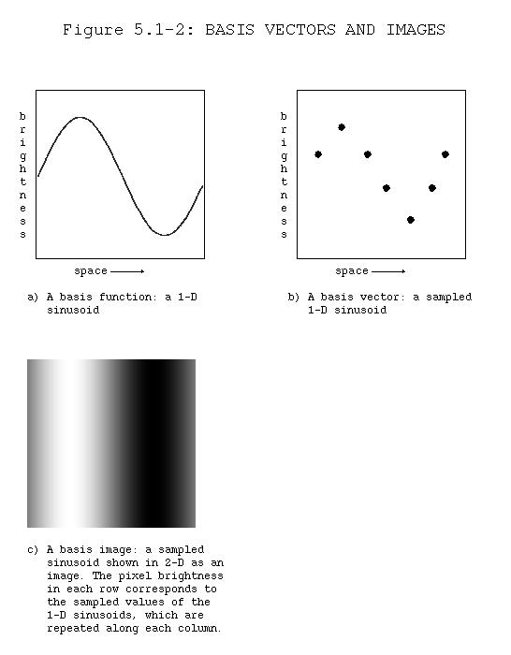
Basis Vectors
10

Slide 11
Spatial frequency and sequency relates to how brightness levels change relative to spatial coordinates
Frequency is the term for sinusoidal transforms, sequency for rectangular wave transforms
Rapidly changing brightness values correspond to high frequency (or sequency) terms, slowly changing brightness values correspond to low frequency (or sequency) terms
11

Slide 12
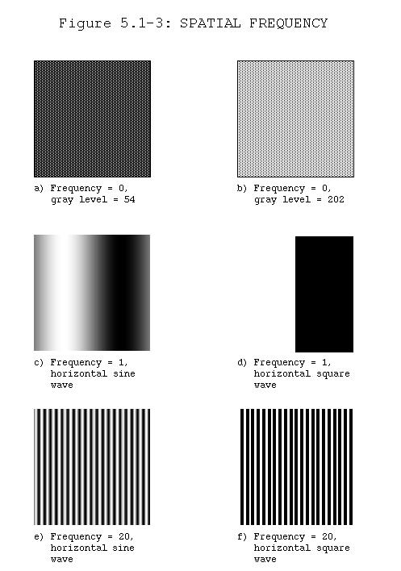
12

Slide 13
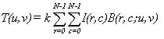
Transformation equation
The lowest spatial frequency, called the zero frequency term ( DC term), corresponds to an image with a constant value
The general form of the transformation equation, assuming an N x N image, is given by:
where
u and v are the frequency domain variables,
k is a constant that is transform dependent,
T (u ,v) are the transform coefficients,
and B (r, c; u ,v) correspond to the basis images
The notation B (r, c; u ,v) defines a set of basis images, corresponding to each different value for u and v, and the size of each is r by c
13

Slide 14
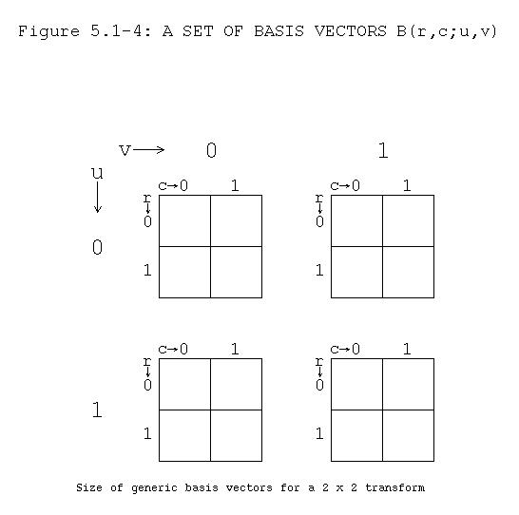
14

Slide 15
Transformation equation
The transform coefficients, T (u ,v), are the projections of I (r ,c) onto each B (u ,v)
These coefficients tell us how similar the image is to the basis image; the more alike they are, the bigger the coefficient
This transformation process amounts to decomposing the image into a weighted sum of the basis images, where the coefficients T (u ,v) are the weights
15

Slide 16
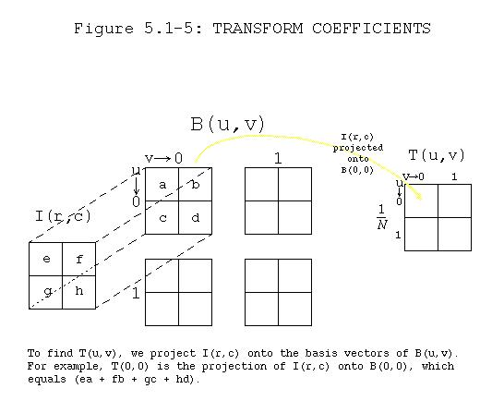
16

Slide 17
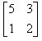
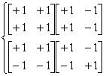
Example
Let I (r,c) =
and let
B (u,v;r,c) =
17

Slide 18
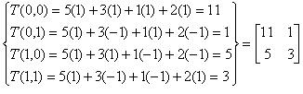
Example
Then T (u ,v)=
18

Slide 19
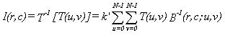
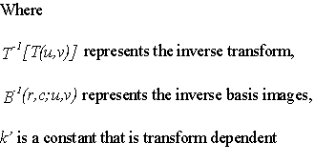
To obtain the image from the transform coefficients we apply the inverse transform equation:
19

Slide 20
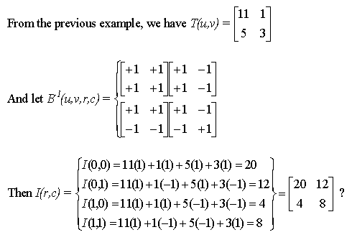
20

Slide 21
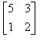
Is this correct?
No, since I (r ,c) =
Comparing our results we see that we must multiply our answer by ¼
It also tells us that the transform pair,
B(u,v;r,c) and B⁻¹(u,v;r,c) are not properly defined, we need to be able to recover our original image to have a proper transform pair
21

Slide 22
Basis images should be orthogonal and ortho normal
Orthogonal basis images
Have vector inner products equal to zero
Have nothing in common
Are uncorrelated
Remove redundant information
Orthonormal basis images
Are orthogonal and have magnitudes of one
22

Slide 23
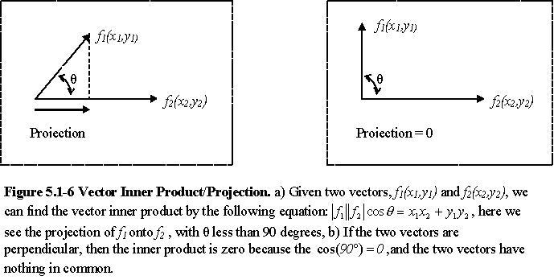
23

Slide 24
Fourier Transform
Many DIP techniques rely on the application of an image transform of which the Fourier Transform is the most popular.
The Fourier domain provides very important insight into the information content of the data.
Fourier transform decomposes a complex signal into a weighted sum of a zero frequency term (the DC term which is related to the average value), and sinusoidal terms, the basis functions, where each sinusoid is a harmonic of the fundamental
The fundamental is the basic or lowest frequency
24

Slide 25
Harmonics are frequency multiples of the fundamental (the fundamental is also called the first harmonic)
Original signal can be recreated by adding the fundamental and all the harmonics, with each term weighted by its corresponding transform coefficient
25

Slide 26
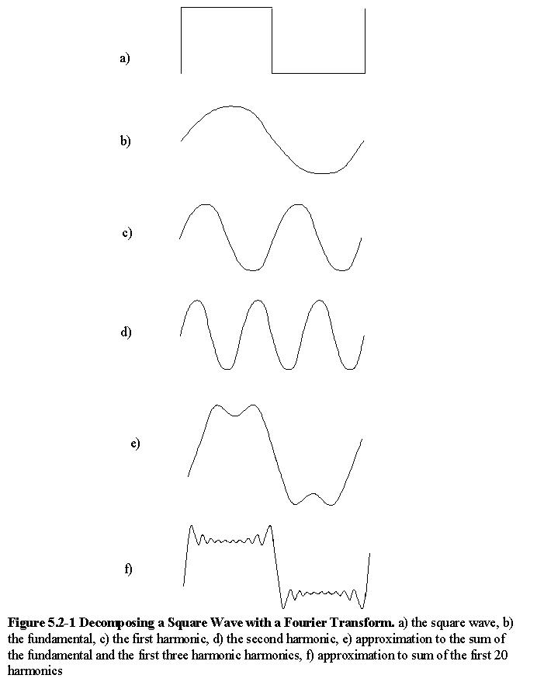
26

Slide 27
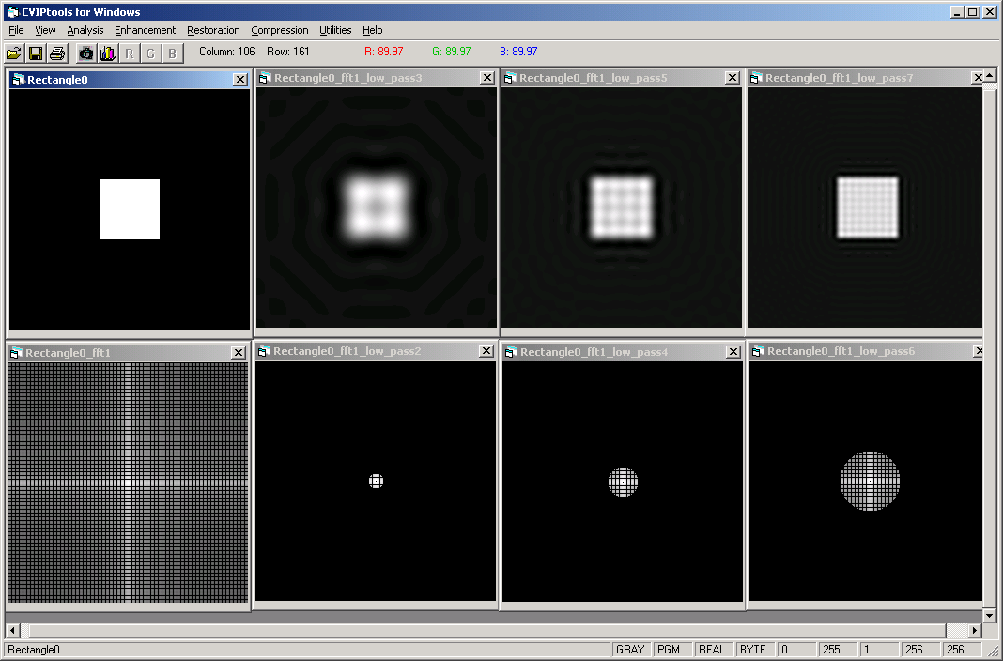
Decomposing a Square Wave with a Fourier Transform
CVIPtools screen capture of a square and successively adding more harmonics across the top are the reconstructed squares with 8, 16 and then 32 harmonics across the bottom are the corresponding Fourier transform magnitude images
27

Slide 28
Fourier Transform
Existence of Fourier Transform:
Dirichletes Conditions:
∫∞-∞ lf(t)l dt < ∞
This Condition is sufficient but not necessary condition.
Functions like sinwt, coswt, u(t) doen’t satisfy the condition but they do have Fourier Transform.
28

Slide 29
The Fourier Transform(contd.,)
The Fourier transform of a continuous function f(x) of a real variable x is defined:
The inverse Fourier transform is:
F(u) = Re{F(u)} + jIm{F(u)} = R(u) + jI(u) = |F(u)|e ^{jf(u)}
Fourier Spectrum of f(x) = |F(u)| = [R²(u) + I²(u)]^{1/2}
Phase Angle of f(x) = f(u) = tan⁻¹[I(u)/R(u)]
Power Spectrum of f(x) = P(u) = |F(u)|2
u is called frequency variable
29

Slide 30
The basis functions, e^{-j2πux}, are complex exponentials and are sinusoidal in nature
Continuous Fourier transform theory assumes that the functions start at -∞ and go to +∞, so they are continuous and everywhere
30

Slide 31
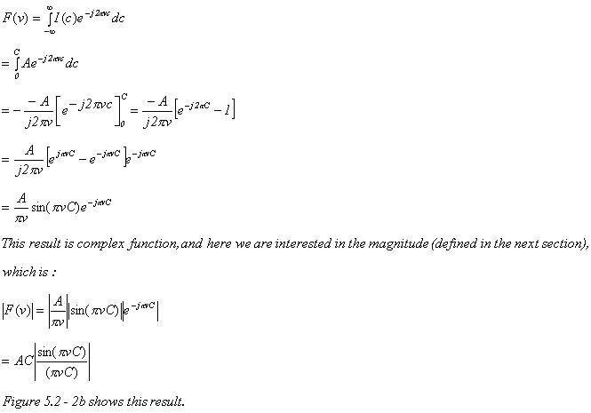
31

Slide 32
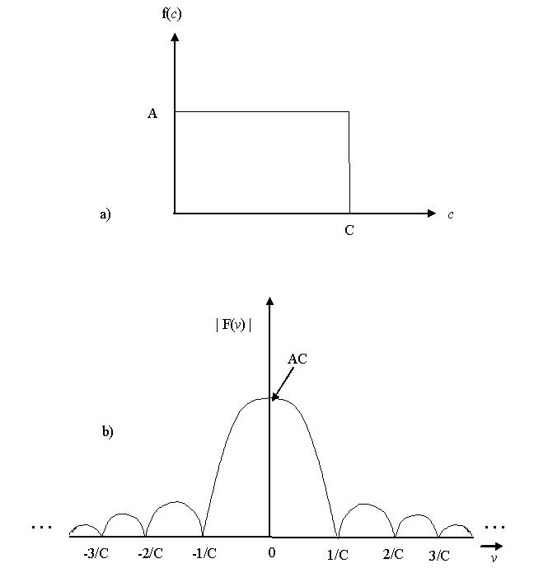
Fourier Transform Example
a) The one-dimensional rectangle function
b) the Fourier transform of the 1-D rectangle function
32

Slide 33
ONE Dimensional Discrete Fourier Transform (DFT)
F(u) = (1/N) È f(x) exp[-j2p(ux/N)
The Inverse DFT is calculated as :
f(x) = È F(u) exp[j2p(ux/N)
33

Slide 34
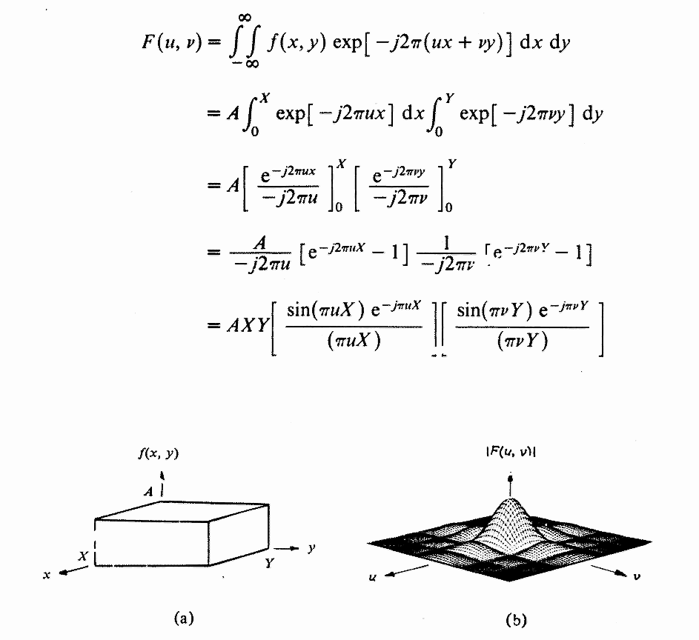
Two Dimensional Fourier Transform:
Example: The "Box Car" Function
y
v
x
u
34

Slide 35
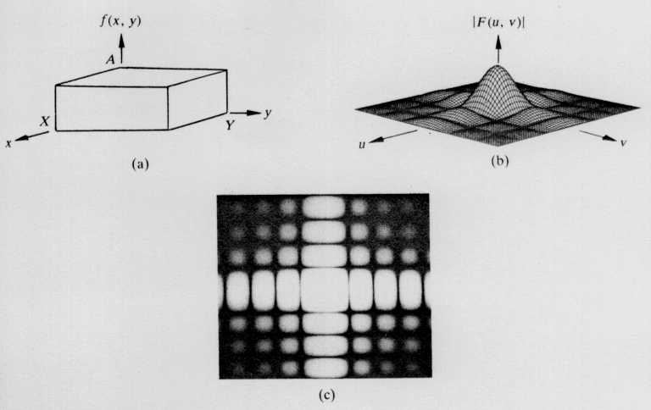
A 2-D Function b. Its Fourier Spectrum c. Spectrum displayed as intensity function
35

Slide 36

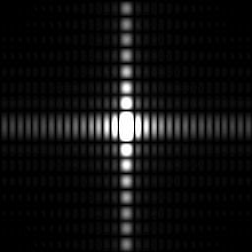
Discrete Fourier Transform Example
a) Two-dimensional rectangle
function as an image
b) Magnitude of Fourier spectrum
of the 2-D rectangle
36

Slide 37
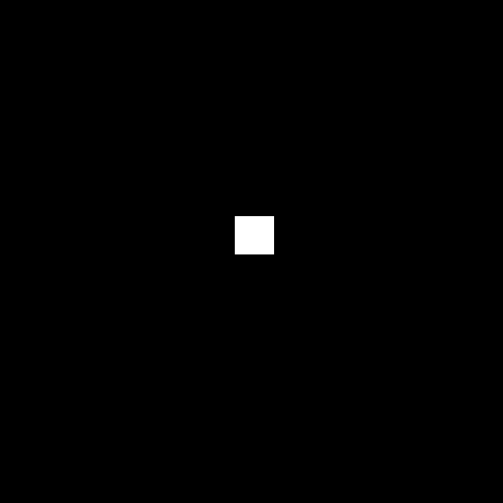
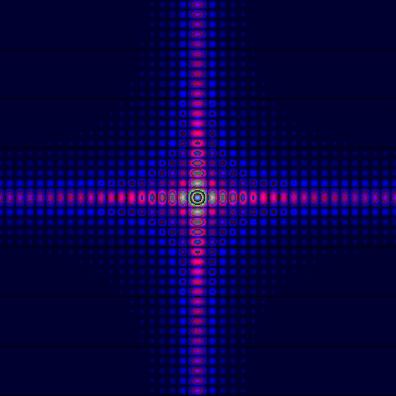
Discrete Fourier Transform Example (contd.,)
37

Slide 38
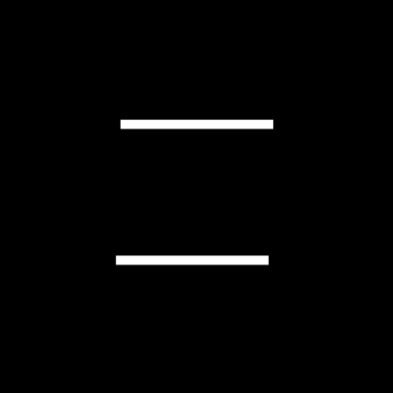

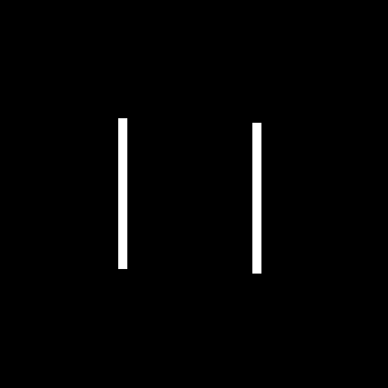
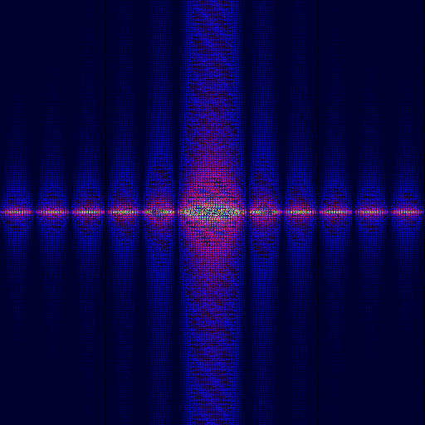
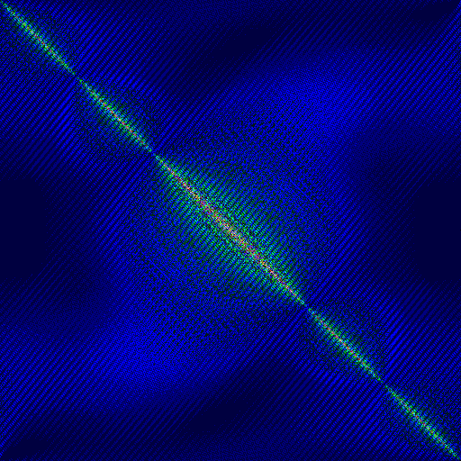

Discrete Fourier Transform Example (contd.,)
38

Slide 39
Discrete Fourier Transform Example (contd.,)
39

Slide 40
Reconstruction of Spatial domain Image from its Fourier Image
The Fourier Transform produces a complex number valued output image which can be displayed with two images, either with the real and imaginary part or with magnitude and phase.
In image processing, often only the magnitude of the Fourier Transform is displayed, as it contains most of the information of the geometric structure of the spatial domain image.
However, if we want to re-transform the Fourier image into the correct spatial domain after some processing in the frequency domain, we must make sure to preserve both magnitude and phase of the Fourier image
40

Slide 41
Discrete Fourier Transform Example (contd.,)
We start off by applying the
Fourier Transform of :
The magnitude calculated from the complex result is shown:
We can see that the DC-value is by far the largest component of the image.
However, the dynamic range of the Fourier coefficients (i.e. the intensity values in the Fourier image) is too large to be displayed on the screen.
Therefore all other values appear as black
41

Slide 42
The result shows that the image contains components of all frequencies, but that their magnitude gets smaller for higher frequencies
The transform image also tells us that there are two dominating directions in the Fourier image, one passing vertically and one horizontally through the center. These originate from the regular patterns in the background of the original image.
If we apply a Logarithmic transformation (log[1+lF(u,v)l) to the image the dynamic range has been compressed from [0, 2.5x10⁶] to [0, 6.4] and we obtain :
42

Slide 43
The phase of the Fourier transform of the same image is shown :
As in the magnitude image, we can identify the vertical and horizontal lines corresponding to the patterns in the original image.
The phase image does not yield much new information about the structure of the spatial domain image.
43

Slide 44
Note that if we apply the Inverse Fourier Transform to the above magnitude image while ignoring the phase (and then histogram equalize the output) we obtain :
Although this image contains the same frequencies (and amount of frequencies) as the original input image, it is corrupted beyond recognition.
This shows that the phase information is crucial to reconstruct the correct image in the spatial domain.
44

Slide 45
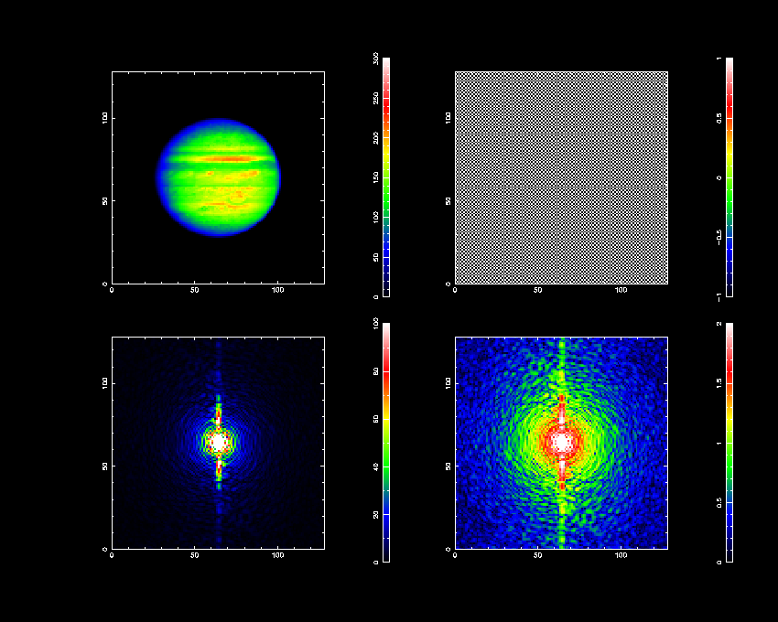
Example of a 2-d DFT calculation
f_{xy}
(-1)^{x+y}
|F_{uv} |
log |F_{uv} |
45

Slide 46
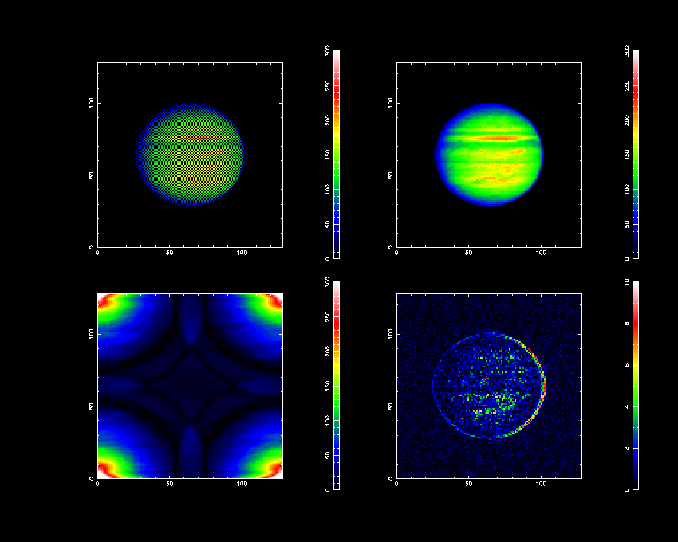
And the Inverse ….
(-1)^{x+y}
Ignoring the phase!
Ignoring the amplitude!
46

Slide 47
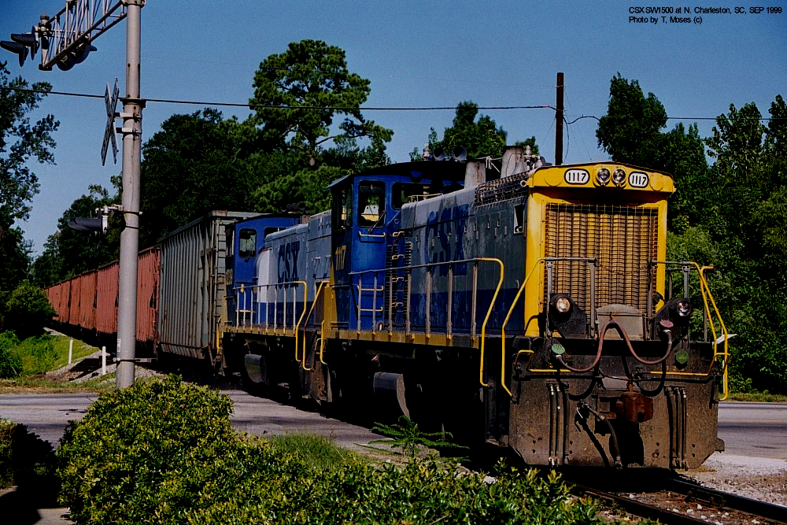
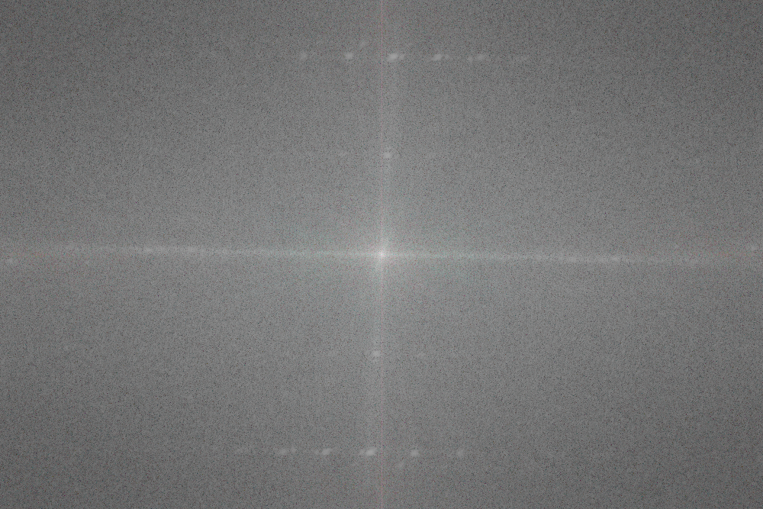
Example of a 2-d DFT
log |F_{uv}|
47

Slide 48
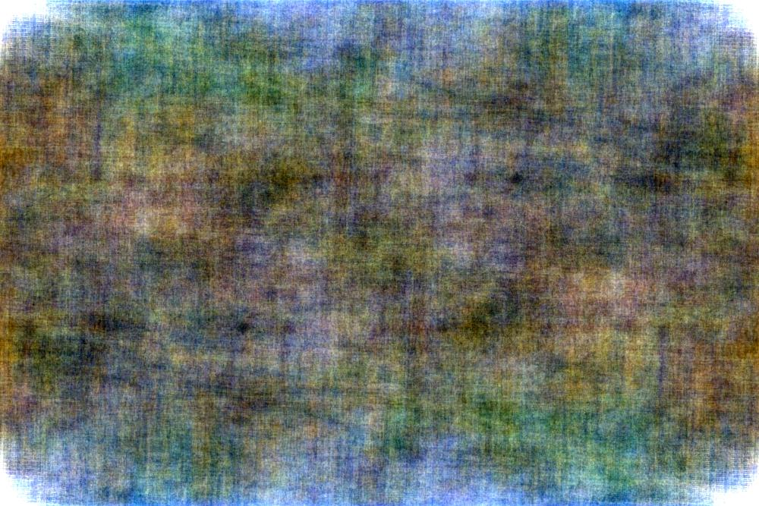
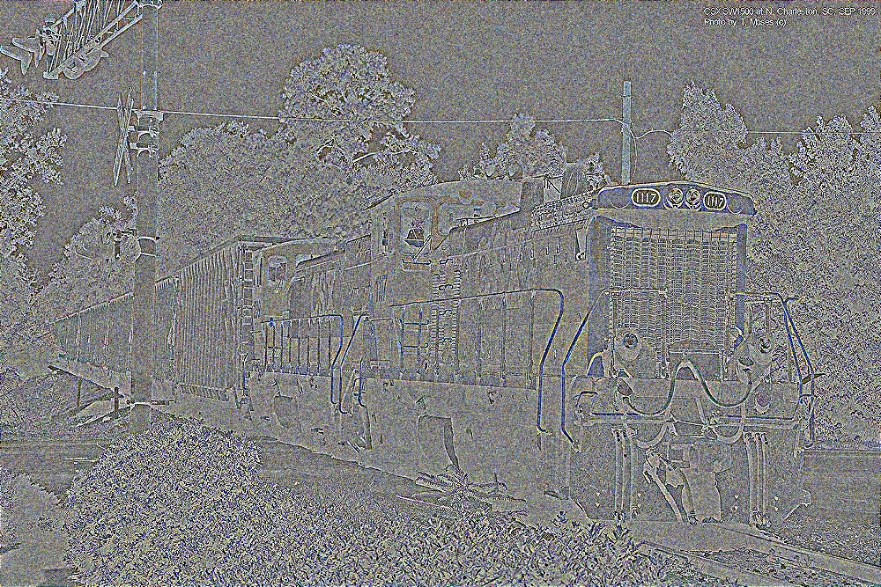
Magnitude-only Reconstruction
Phase-only Reconstruction
48

Slide 49
Properties of the 2D Discrete Fourier Transformation
Separability
Translation
Periodicity and Conjugate Symmetry
Rotation
Distributivity and Scaling
Average Value
Laplacian
Convolution and Correlation
Sampling
49

Slide 50
Separability Property
The DFT can be expressed in the separable forms.
The principal advantage is that F(u,v) or f(x,y) can be obtained in two steps by successive applications of the 1D Fourier transform or its inverse.
From, M=N, and for convenient operation:
where
50

Slide 51
(0,0)
(N-1)
y
(N-1)
v
(0,0)
(0,0)
(N-1)
v
f(x,y)
Row Transforms
F(x,v)
Coloumn
Transforms
F(u,v)
F(u,v)
(N-1)
(N-1)
x
x
u
After Row After Column
Original Image Transformation Transformation
51

Slide 52
Translation Property
f(x,y) exp[j2p(u₀x + v₀y)/N] ←→ F(u – u₀, v – v₀)
and
f(x – x₀, y – y₀) ←→ F(u,v)exp[-j2p(ux₀ + vy₀)/N]
If u₀= v₀ = N/2 then
exp[j2p(u₀x + v₀y)/N] = exp[jp (x+y)] = (-1)^{x+y}
and
f(x,y) (-1)^{x+y} ←→F (u-N/2,v-N/2)
So, origin of the Fourier Transform of f(x,y) can be moved to the center of its corresponding NxN frequency square simply by multiplying f(x,y) by (-1)^{x+y.}
In the one variable case this shift reduces to multiplication of f(x) by the term (-1)^{x.}
52

Slide 53
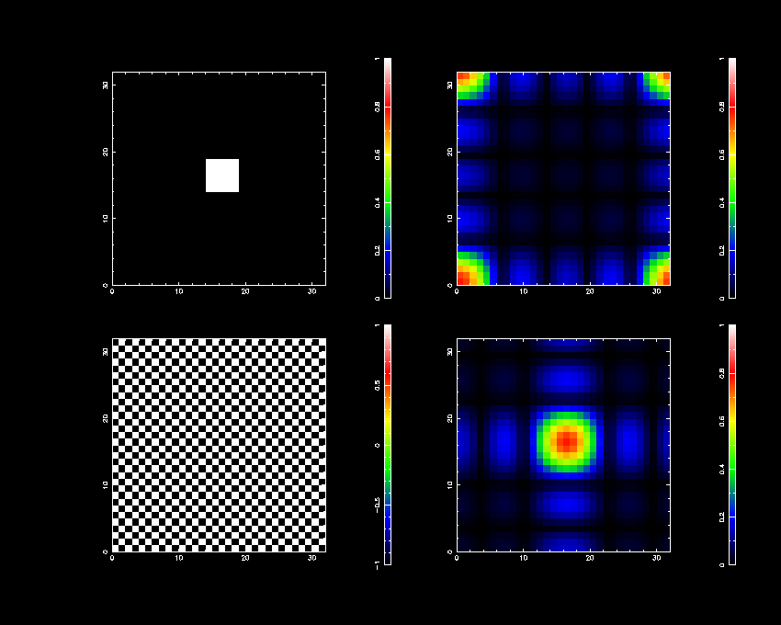
The Optical Transform
A trick to shift the (u,v) origin from the top left corner to the centre of the F_{uv} image is to multiply the input image by alternate 1’s and -1’s before computing the DFT i.e.
53

Slide 54

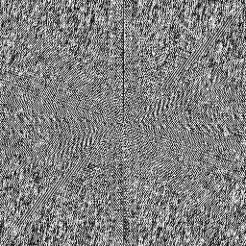
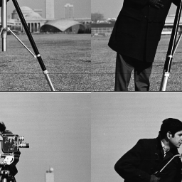
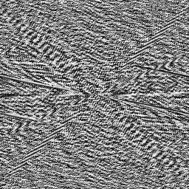
Displaying Phase Shows Phase Change
Phase of the Fourier
spectrum of (a)
a) Original image
b) Original image shifted by
128 rows and 128 columns
Phase of the Fourier
spectrum of (b)
54

Slide 55
Periodicity and Conjugate Symmetry
From the above equations we note that a shift in spatial domain f(x,y) will affect a phase shift in frequency spectrum not its magnitude, as
lF(u,v)exp[-j2p(ux₀ + vy₀)/N]l = lF(u.v)l
But visual examination of the transform is usually limited to a display of its magnitude
55

Slide 56
Periodicity and Conjugate Symmetry
The DFT and its inverse are periodic with period N:
F(u,v) = F(u+N,v) = F(u,v+N) = F(u+N,v+N)
If f(x,y) is real, the Fourier transform exhibits conjugate symmetry:
F(u,v) = F*(-u,-v)
and |F(u,v)| = |F(-u,-v)|
56

Slide 57
Periodicity Property
One Dimensional Periodicity Property:
Two Dimensional Periodicity Property:
Square Fourier Spectrum Fourier Spectrum
with out shifting shifted to the Center
of the frequency square
57

Slide 58
Rotation Property
If we introduce the polar coordinates:
x = rcosq y = rsinq u = wcosf v = wsinf
then f(x,y) → f(r,q) and F(u,v) → F(w,f)
When there is a rotation of f(r,q+q₀), its transform becomes
f(r,q+q₀) ←→ F(wf+ q₀)
So, rotating f(x,y) by an angle q₀ will rotates F(u,v) by the same angle.
58

Slide 59
ILLUSTRATION OF ROTATION PROPERTY:
59

Slide 60
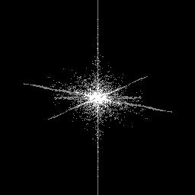
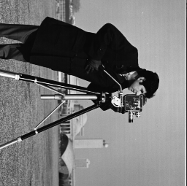
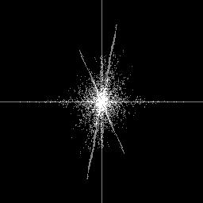
Rotation Property
a) Original image
b) Fourier spectrum image of original image
Rotation results in Corresponding Rotations with Image and Spectrum
c) Original image rotated by 90 degrees
d) Fourier spectrum image of rotated image
60

Slide 61
Distributivity and Scaling Properties
The Fourier transform and its inverse are distributive over addition.
F{f₁(x,y) + f₂(x,y)} = F{f₁(x,y)} + F{f₂(x,y)}
af(x,y) ←→ aF(u,v)
f(ax,by) ←→ (1/|ab|)F(u/a,v/b)
61

Slide 62
Average Value
The average value of a 2D discrete function is:
Substituting u = 0, and v = 0 in F(u,v), then
Therefore
62

Slide 63
Laplacian
The Laplacian of a two-variable function f(x,y) is defined as:
And its 2D Fourier transform is:
The Laplacian operator is useful for outlining edges in an image.
63

Slide 64
Convolution and Correlation
Because of periodicity property that exists in DFT of any function f(x,y), so zero padding must be exploited to extend sequences before execute the convolution or correlation operations.
If this process is not executed, the wrap around error will occur.
One of principal applications of correlation in image processing is in the area of template or prototype matching.
f(x,y) * g(x,y) ←→ F(u,v)G(u,v)
f(x,y) o g(x,y) ←→ F*(u,v)G(u,v)
64

Slide 65
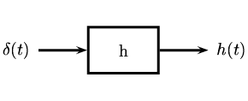
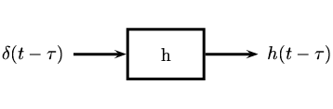
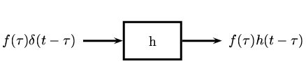
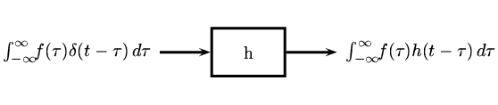
Impulse Response Illustration:
:Impulse Response
: Shifting Property
:Scaling Property
Additivity
aspect
65

Slide 66
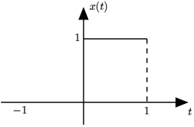

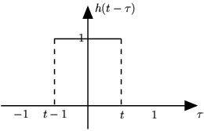
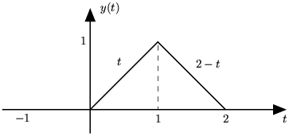
Convolution Illustration:
We will convolve together two unit pulses, x(t) and h(t) .
Reflect and Shift
Convolution Result
66

Slide 67
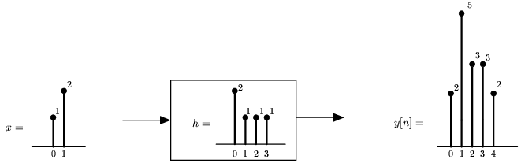
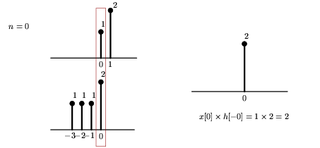
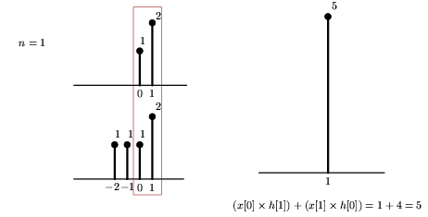
Correlation Illustration:
67

Slide 68


(Contd.,)
68

Slide 69
The Fast Fourier Transform (FFT)
The FFT algorithm is based on the decimation technique.
A comparison of N² versus Nlog₂N for various values of N
N Direct DFT: N² FFT: Nlog₂N Computational Advantage:
N/log₂N
2 4 2 2.00
4 16 8 2.00
8 64 24 2.67
16 256 64 4.00
32 1,024 160 6.40
64 4,096 384 10.67
128 16,384 896 18.29
256 65,536 2,048 32.00
512 262,144 4,608 56.89
1,024 1,048,576 10,240 102.40
69

Slide 70
Decimation-in-Time FFT Algorithm
The N-point DFT of sequence x[n] is given by:
X[k] = ∑ x[n]W_{N}^{nk} , n and k = [0,N-1]
Where W_{N} = exp(j2p/N)
Then, breaking x[n] into its even and odd numbered value:
X[k] = ∑ _{n even} x[n]W_{N}^{nk} + ∑ _{n odd} x[n]W_{N}^{nk}
Where n = 2r for n even, and n = 2r+1 for n odd
X[k] = ∑ x[2r](W_{N}²)^{rk} + W_{N}^{k} ∑ x[2r+1](W_{N}²)^{rk}, r = [0,N/2-1]
= ∑ x[2r]W_{N/2}^{rk} + W_{N}^{k} ∑ x[2r+1]W_{N/2}^{rk},
70

Slide 71
Radix-2 FFT Algorithm
N/2 Point DFT
N/2 Point DFT
71

Slide 72
Radix-2 FFT Algorithm
N/4 Point
DFT
N/4 Point
DFT
N/4 Point
DFT
N/4 Point
DFT
72

Slide 73
Radix-2 FFT Algorithm
73

Slide 74
OTHER SEPERABLE IMAGE TRANSFORMS:
T (u) = ∑ f (x) g (x, u), x=0 to (N-1)
g (x, u): Forward Transformation kernel or Basis Function
Seperability property of kernel:
g (x, y,u,v) = g₁(x,u) g ₂(y,v)
Symmetric property of kernel:
If g₁ is functional equal to g₂
Seperable & Symmeric:
g (x, y,u,v) = g₁(x,u) g ₁(y,v)
74

Slide 75
END
75

